Slide 1
Number Systems
System | Base | Symbols
Decimal | 10 | 0, 1, … 9
Binary | 2 | 0, 1
Octal | 8 | 0, 1, … 7
Hexa- decimal | 16 | 0, 1, … 9, A, B, … F

Slide 2
Counting
Decimal | Binary | Octal | Hexa- decimal
0 | 0 | 0 | 0
1 | 1 | 1 | 1
2 | 10 | 2 | 2
3 | 11 | 3 | 3
4 | 100 | 4 | 4
5 | 101 | 5 | 5
6 | 110 | 6 | 6
7 | 111 | 7 | 7

Slide 3
Counting
Decimal | Binary | Octal | Hexa- decimal
8 | 1000 | 10 | 8
9 | 1001 | 11 | 9
10 | 1010 | 12 | A
11 | 1011 | 13 | B
12 | 1100 | 14 | C
13 | 1101 | 15 | D
14 | 1110 | 16 | E
15 | 1111 | 17 | F

Slide 4
Counting
Decimal | Binary | Octal | Hexa- decimal
16 | 10000 | 20 | 10
17 | 10001 | 21 | 11
18 | 10010 | 22 | 12
19 | 10011 | 23 | 13
20 | 10100 | 24 | 14
21 | 10101 | 25 | 15
22 | 10110 | 26 | 16
23 | 10111 | 27 | 17

Slide 5
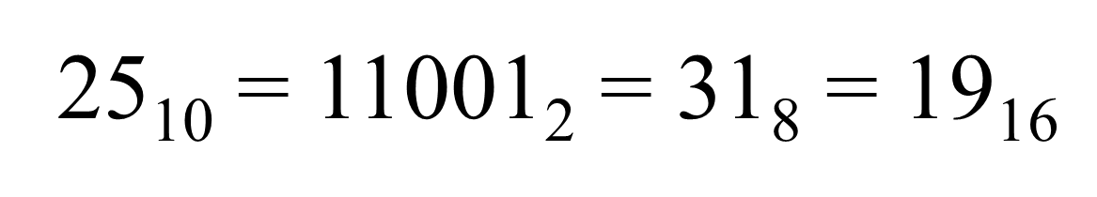
Example

Slide 6
Decimal →Decimal
Multiply each bit by 10^{n}, where n is the “position” of the bit starting from 0 on the right
Add the results
125₁₀ => 5 x 10⁰ = 5 2 x 10¹ = 20 1 x 10² = 100 125

Slide 7
Binary →Decimal
Multiply each bit by 2^{n}, where n is the “position” of the bit starting from 0 on the right
Add the results
101011₂ => 1 x 2⁰ = 1 1 x 2¹ = 2 0 x 2² = 0 1 x 2³ = 8 0 x 2⁴ = 0 1 x 2⁵ = 32
43₁₀

Slide 8
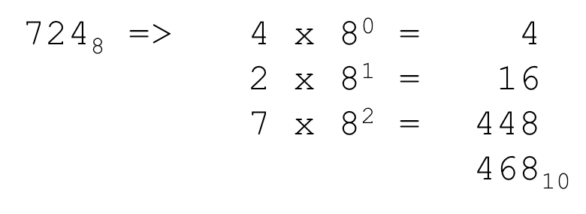
Octal →Decimal
Multiply each bit by 8^{n}, where n is the “position” of the bit starting from 0 on the right
Add the results

Slide 9
Hexadecimal →Decimal
Multiply each bit by 16^{n}, where n is the “position” of the bit starting from 0 on the right
Add the results
ABC₁₆ => C x 16⁰ = 12 x 1 = 12 B x 16¹ = 11 x 16 = 176 A x 16² = 10 x 256 = 2560
2748₁₀

Slide 10
Decimal →Binary
125₁₀ = ?₂
Divide by 2 and keep track of the remainder
Quotient
Remainder
125 /2 | 62 | 1
62/2 | 31 | 0
31/2 | 15 | 1
15/2 | 7 | 1
7/2 | 3 | 1
3/2 | 1 | 1
1/2 | 0 | 1
125₁₀ = 1111101₂

Slide 11
Decimal →Octal
1234₁₀ = ?₈
Divide by 8 and keep track of the remainder
Quotient
Remainder
1234/8 | 154 | 2
154/8 | 19 | 2
19/8 | 2 | 3
2/8 | 0 | 2
1234₁₀ = 2322₈

Slide 12
Decimal →Hexadecimal
1234₁₆ = ?₈
Divide by 16 and keep track of the remainder
Quotient
Remainder
1234/16 | 77 | 2
77/16 | 4 | D
4/16 | 0 | 4
1234₁₀ = 4D2₁₆

Slide 13
Binary →Octal
1011010111₂ = ?₈
Group bits in threes, starting on right
Convert to octal digits
1 011 010 111
1 3 2 7
1011010111₂ = 1327₈

Slide 14
Binary →Hexadecimal
1011011111₂ = ?₁₆
Group bits in fours, starting on right
Convert to hexadecimal digits
10 1101 1111
2 D F
1011010111₂ = 2DF₈

Slide 15
Octal to Hexadecimal
Use binary as an intermediary
1076₈ = ?₁₆
1076₈ = 001 000 111 110 = 0010 0011 1110= 23E₁₆

Slide 16
Exercise
Decimal | Binary | Octal | Hexa- decimal
33
 | 1110101
 |  | 703
 |  |  | 1AF

Slide 17
Answers
Decimal | Binary | Octal | Hexa- decimal
33 | 100001 | 41 | 21
117 | 1110101 | 165 | 75
451 | 111000011 | 703 | 1C3
431 | 110101111 | 657 | 1AF

Slide 18
Fractions
Decimal to decimal
3.14 => 4 x 10⁻² = 0.04 1 x 10⁻¹ = 0.1 3 x 10⁰ = 3 3.14

Slide 19
Fractions
Binary to decimal
10.1011 => 1 x 2⁻⁴ = 0.0625 1 x 2⁻³ = 0.125 0 x 2⁻² = 0.0 1 x 2⁻¹ = 0.5 0 x 2⁰ = 0.0 1 x 2¹ = 2.0 2.6875

Slide 20
Fractions- Decimal to Binary
.14579 x 2 0.29158 x 2 0.58316 x 2 1.16632 x 2 0.33264 x 2 0.66528 x 2 1.33056
etc.
3.14579 → Binary
11.001001...

Slide 21
Binary Addition

Slide 22
Hexadecimal Addition
carry=1
36 28 28 6A
42 45 58 4B
78 6D 80 B5
21 / 16 = 1, rem 5

Slide 23
Signed Integers
Stored using Two’s complement notation

Slide 24
8-bit 2’s Complement Examples
Example #1
5 = 00000101
↓↓↓↓↓↓↓↓
Complement Digits
11111010
+1
Add 1
-5 = 11111011
Example #2
-13 = 11110011
↓↓↓↓↓↓↓↓
Complement Digits
00001100
+1
Add 1
13 = 00001101
Notes:
Examples of the 2’s Complement Process.

Slide 25
8-bit Two’s Complement Examples
8-bit two’s complement | Decimal
00000111 | 7
00000110 | 6
00000101 | 5
00000100 | 4
00000011 | 3
00000010 | 2
00000001 | 1
00000000 | 0
11111111 | -1
11111110 | -2
11111101 | -3
11111100 | -4
11111011 | -5
11111010 | -6
11111001 | -7
11111000 | -8
Most significant bit (MSB) indicates positive or negative.
MSB = 0 positive
MSB=1 negative
To find the magnitude of a negative number, apply 2s complement as in the previous example 2.

